Slide 1

Movies Recommendation System
Group 1
Zhanna Borodaeva
Javier Aguilar
Shravanti Yerawar
Martin Hamilton

Slide 2
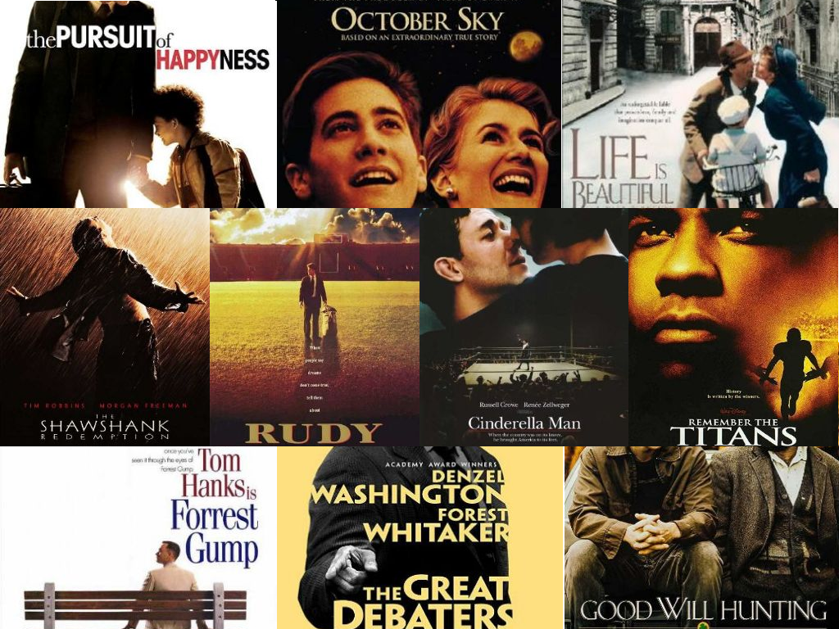
PROJECT TASKS
WBSFLIX is a DVD online store
WBSFLIX wants to develop an individual movies recommendation system
The recommendation system should be deployed as a Streamlit app

Slide 3
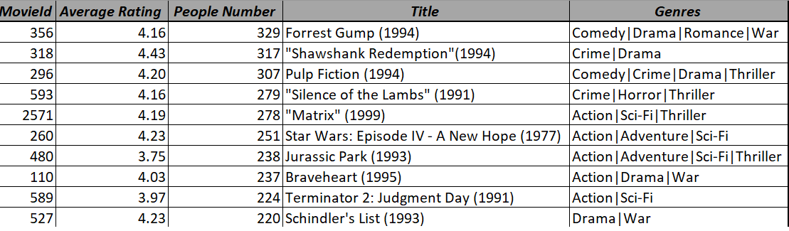
Popularity Based Recommender:
Average Rating + Number of Reviews

Slide 4
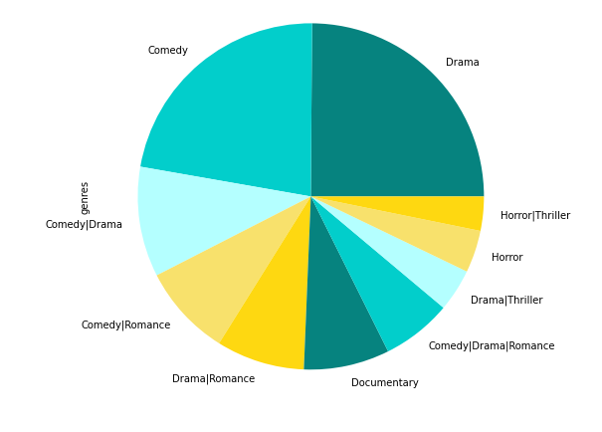
Top 10 Genres

Slide 5
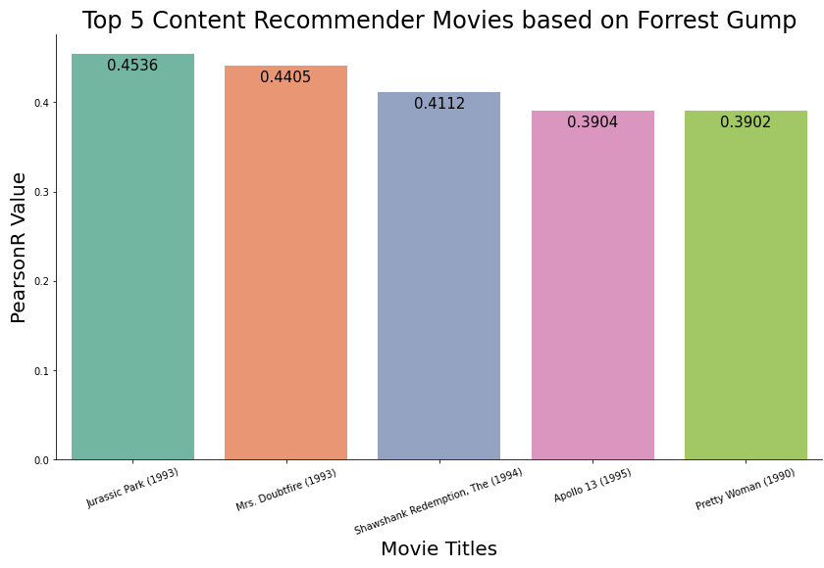
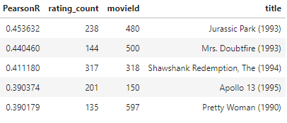
Content-based Recommender
mostPopularMovieId : 356
Forrest Gump (1994)

Slide 6
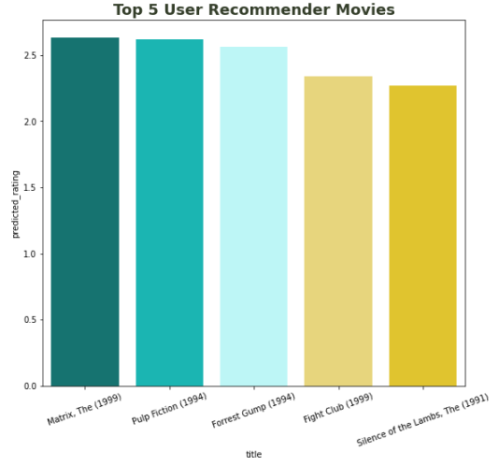
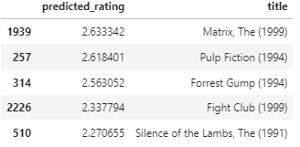
User-based Recommender
Ex: User ID 472

Slide 7
🍿 WBSFLIX+
https://itsjavi-movies-recommender-main-yna3kt.streamlitapp.com

Slide 8
Conclusion
In conclusion with more time we could have done more experimentation
We could see that manipulating the various features would allow recommendations for different target groups
Nowadays most companies are using a hybrid approach with both collaborative & content based methods
BellKor's Pragmatic Chaos team
Predictive accuracy is substantially improved when blending multiple predictors. Our experience is that most efforts should be concentrated in deriving substantially different approaches, rather than refining a single technique. Consequently, our solution is an ensemble of many methods.
As a project the group agree that it was an interesting & enjoyable task
Particularly seeing how the code is used in Streamlit App
Notes:
manipulation using timestamp to group time periods, genre filtering or even trying to combine the different filtering methods
we would also have liked to have been able to validate our results
Collaborative filtering approaches build a model from a user's past behavior (items previously purchased or selected and/or numerical ratings given to those items) as well as similar decisions made by other users
Content-based filtering approaches utilize a series of discrete, pre-tagged characteristics of an item in order to recommend additional items with similar properties
Collaborative filtering - requires a large amount of information about a user to make accurate recommendations
Content-based filtering needs very little information to start - but it is far more limited in scope for example, it can only make recommendations that are similar to the original input(movie)
Netflix Prize 2009 won by BellKor's Pragmatic Chaos team
As a project the group agree that it was an interesting & enjoyable task
older the movie the more ratings it will have
recent top movies
maybe restrict ratings to one year (to show what users liked recently)

